Slide 1
Elena Boydeva
SoftServe IT Academy – Second Demo

Slide 2
The Task:
Manage the employees in company.
Hierarchy:
1) CEO
2) Delivery Director
3) Project Manager
4) Team Leader
5) Senior
6) Intermediate
7) Junior
8) Trainee
=> Information about every employee
=> Add new employee, see and edit the existing ones
=> Choose Trainee, Junior, Intermediate, Senior and Team Lead to team
=> See information about team
=> Move employees to different teams and delivery verticals

Slide 3
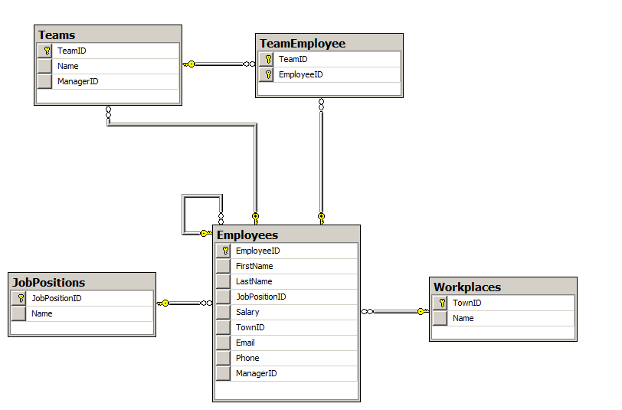

Slide 4
Controllers: EmployeeController
Important Actions:
public ActionResult Create(Employee employee)
public ActionResult Details(int id)
public ActionResult Edit(Employee employee)
TeamController
Important Actions:
public ActionResult Create(Team team)
public ActionResult Edit(int id, Team objTeam)
public ActionResult Details(int id)
public ActionResult AddEmployeeToTeam(int id, Employee emp)
public ActionResult DeleteEmployeeFromTeam(int id, Employee employee)

Slide 5
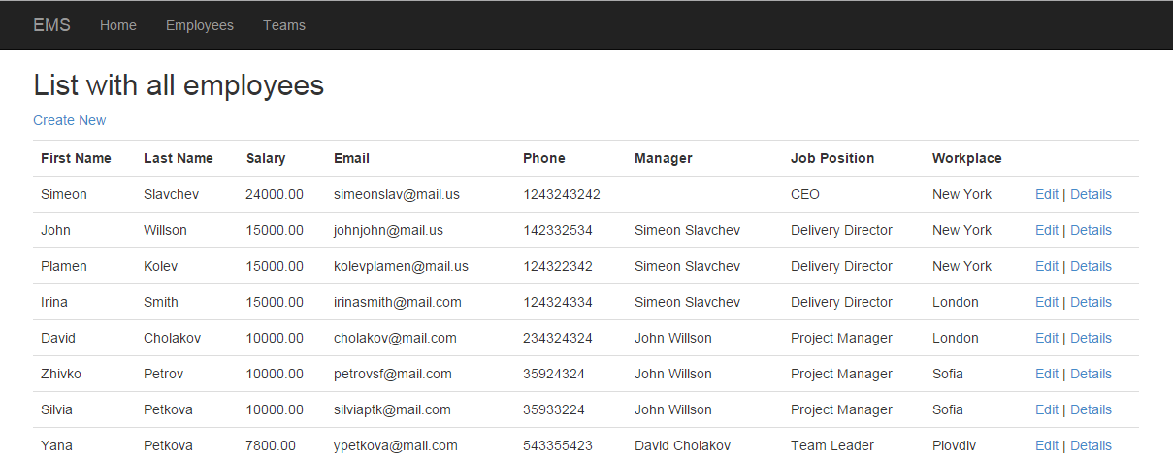
Views

Slide 6
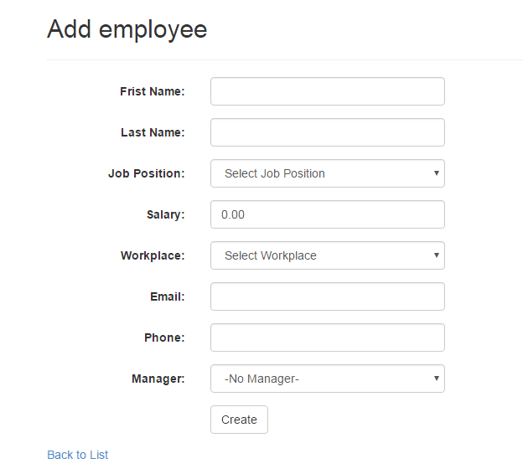

Slide 7
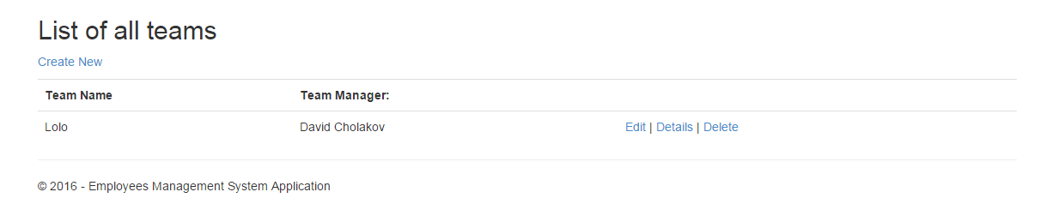
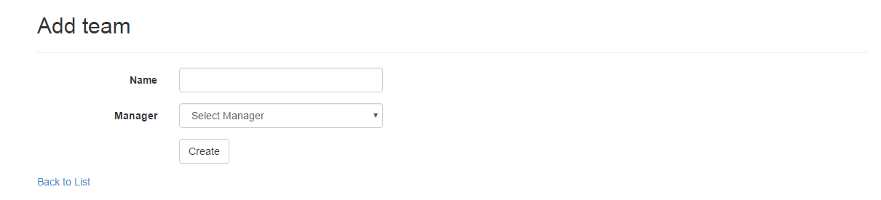
__________________________________________________________________________________________

Slide 8
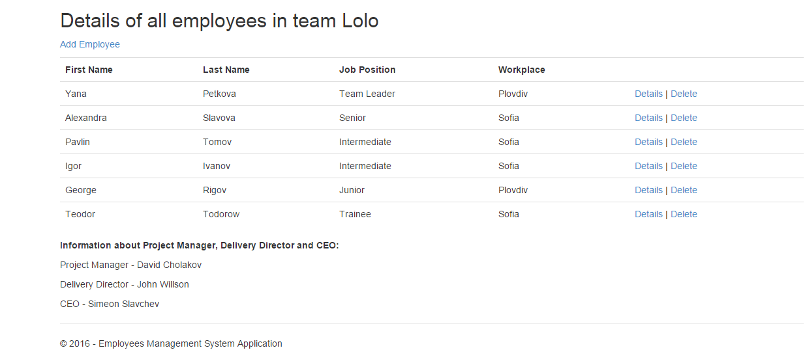

Slide 9
Input in the database
Simeon Slavchev
John Wilson
David Cholakov
Plamen Kolev
Irina Smith
Zhivko Petrov
Silvia Petkova
Yana Petkova
Alexandra Slavova
Pavlin Tomov
George Rigov
Teodor Todorow
Igor Ivanov
CEO
Delivery Director
Project Manager
Team Leader
Senior
Intermediate
Junior
Trainee

Slide 10
Main Logic:
-> When adding an employee the choice of managers could be bound by the job position of the current employee. If we want to add Delivery Director, the manager must be with job position CEO, Project Manager => Delivery Director. The other emoloyees TL, S, I, J, Tr will leave with no manager until we want to add them into team.
->When adding a team we choose the Project Manager of the team. Then we start adding employees as follows Team Lead, Senior, Intermediate, Junior, Trainee everyone of them in the team start having manager one position higher in the team.
-> When deleting a team we release all employees from their managers. And they are free to be added in another team.
-> When trying to add second Team Lead in the current team -> redirect to page with message error.
-> When trying to add Senior Before Team Lead in team -> redirect to page with message error and instrutions how to add employees in team

Slide 11
The code

Slide 12
THANK YOU!

